Slide 1
OPIM 5604
Predictive Modeling
K Nearest Neighbors
Jennifer Eigo, Instructor in-Residence

Slide 2
Characteristics
Data-driven, not model-driven
Makes no assumptions about the data
Conceptually simple/straightforward

Slide 3
Basic Idea
For a given record to be classified, identify nearby records
“Near” means records with similar predictor values X₁, X₂, … X_{p}
Classify the record as whatever the predominant class is among the nearby records (the “neighbors”)

Slide 4
How to measure “nearby”?
The most popular distance measure is Euclidean distance

Slide 5
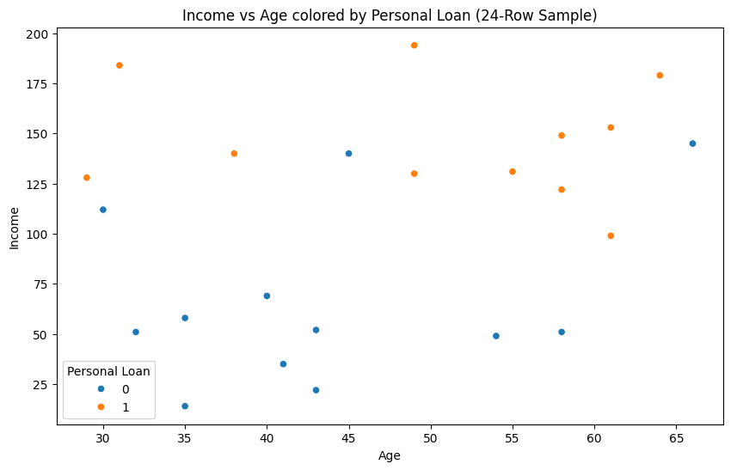
Classifying using nearest neighbors
A new customer: Income $150k and Age 47
The 3 nearest neighbors are 1 and 12 (accept the loan), and 25 (did not accept)
Decision: Classify as “accept” (class = 1)
12
23
1

Slide 6
Choosing k
K is the number of nearby neighbors to be used to classify the new record
    K=1 means use the single nearest record
    K=5 means use the 5 nearest records
Typically choose that value of k which has lowest error rate in validation data

Slide 7
Low k vs. High k
Low values of k (1, 3, …) capture local structure in data (but also noise)
High values of k provide more smoothing, less noise, but may miss local structure
Note: the extreme case of k = n (i.e., the entire data set) is the same as the “naïve rule” (classify all records according to majority class)

Slide 8
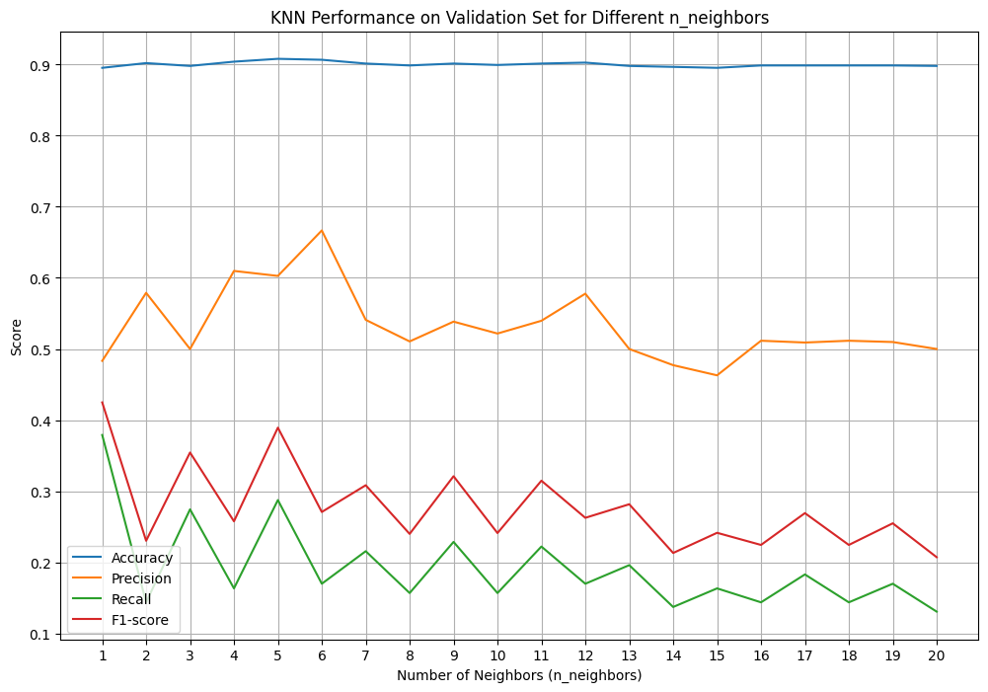
Selecting the best k

Slide 9
Using K-NN for Prediction
(for Numerical Outcomes)
Instead of “majority vote determines class” use average of response values
May be a weighted average, weight decreasing with distance

Slide 10
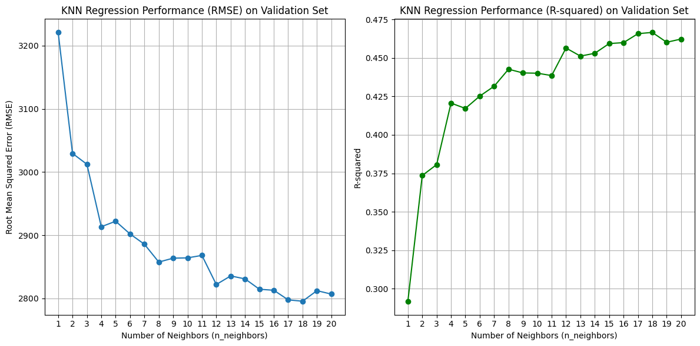
Selecting the best k

Slide 11
Advantages
Simple
No assumptions required about Normal distribution, etc.
Effective at capturing complex interactions among variables without having to define a statistical model

Slide 12
Shortcomings
Required size of training set increases exponentially with # of predictors, p
    This is because expected distance to nearest neighbor increases with p (with large vector of predictors, all records end up “far away” from each other)
In a large training set, it takes a long time to find distances to all the neighbors and then identify the nearest one(s)
These constitute “curse of dimensionality”
  Can be addressed with PCA

Slide 13
Summary
Find distance between record-to-be-classified and all other records
Select k-nearest records
    Classify it according to majority vote of nearest neighbors
    Or, for prediction, take the as average of the nearest neighbors
“Curse of dimensionality” – need to limit # of predictors

